Slide 1
PHISHING
Mohammed shaad matcheswala (21065793)
Cmt116 - CYBER SECURITY AND RISK MANAGEMENT

Slide 2
Topics covered
What is a phishing?
History of phishing.
Types of phishing attacks.
How are phishing attacks performed?
Ways to be protected from phishing.
References.

Slide 3

What is a phishing?
Phishing is a type of social engineering where an attacker sends a fraudulent message designed to trick a human victim into revealing sensitive information to the attacker or to deploy malicious software on the victim's infrastructure like ransomware.[1]
Social engineering is the art of manipulating people so they give up confidential information.[2]

Slide 4
History of phishing
The concept of phishing can be traced back to the 1990s. An American Online (AOL) group calling themselves “The Warez Community”, conducted rudimentary attacks at large corporate targets.
In one example, they designed an algorithm that allowed them to generate random credit card numbers, which then allowed them to create AOL accounts once they hit upon a real credit card number. Once they had an account, they could spam other accounts and build the attack over time.[3]

Slide 5
Types of phishing attacks.
Spear phishing is a phishing method that targets specific individuals or groups within an organization.
It is a potent variant of phishing, a malicious tactic which uses emails, social media, instant messaging, and other platforms to get users to divulge personal information or perform actions that cause network compromise, data loss, or financial loss.[5]

Slide 6
Types of phishing attacks.
Whaling is an even more targeted type of phishing that goes after the whales.
These attacks typically target a CEO, CFO, or any CXX within an industry or a specific business.
Example:- A whaling email might state that the company is facing legal consequences and that you need to click on the link to get more information.
The link takes you to a page where you are asked to enter critical data about the company such as tax ID and bank account numbers.[4]

Slide 7
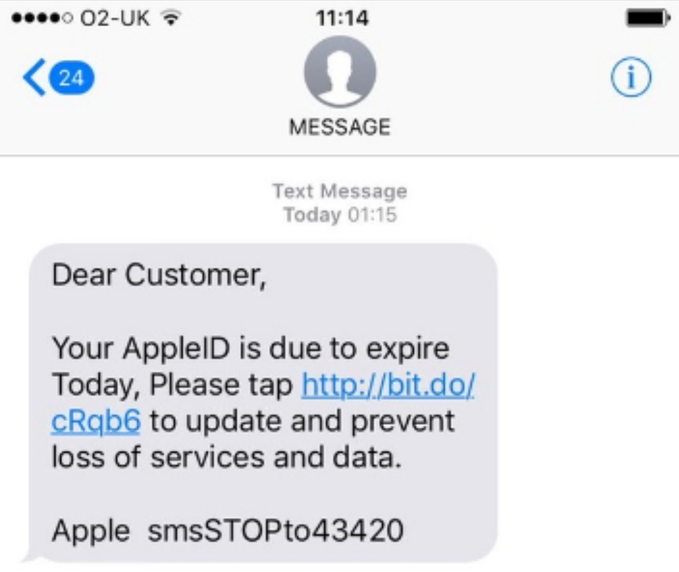
Types of phishing attacks.
Smishing is an attack that uses text messaging or short message service (SMS) to execute the attack. A common smishing technique is to deliver a message to a cell phone through SMS that contains a clickable link or a return phone number.
Example:-A common example of a smishing attack is an SMS message that looks like it came from your banking institution. It tells you your account has been compromised and that you need to respond immediately. The attacker asks you to verify your bank account number, SSN, etc. Once the attacker receives the information, the attacker has control of your bank account.[4]

Slide 8
Types of phishing attacks.
Vishing has the same purpose as other types of phishing attacks. The attackers are still after your sensitive personal or corporate information. This attack is accomplished through a voice call. Hence the “v” rather than the “ph” in the name.
A common vishing attack includes a call from someone claiming to be a representative from Microsoft. This person informs you that they’ve detected a virus on your computer. You’re then asked to provide credit card details so the attacker can install an updated version of antivirus software on your computer.
The attacker now has your credit card information and you have likely installed malware on your computer.
The malware could contain anything from a banking Trojan to a bot (short for robot). The banking Trojan watches your online activity to steal more details from you – often your bank account information, including your password.
A bot is software designed to perform whatever tasks the hacker wants it to. It is controlled by command and control (C&C) to mine for bitcoins, send spam, or launch an attack as part of a distributed denial of service (DDoS) attack.[4]

Slide 9
Types of phishing attacks.
Search engine phishing, also known as SEO poisoning or SEO Trojans, is where hackers work to become the top hit on a search using a search engine.
Clicking on their link displayed within the search engine directs you to the hacker’s website. From there, threat actors can steal your information when you interact with the site and/or enter sensitive data.
Hacker sites can pose as any type of website, but the prime candidates are banks, money transfer, social media, and shopping sites.[4]

Slide 10
How are phishing attacks performed?
Just to show how phishing attacks are performed, I have put together an example which I can demonstrate in the following slides.
This will give a brief description of how an phishing attack is performed in a simple way.
I have used the Kali Linux Operating system to generate the phishing attacks.

Slide 11
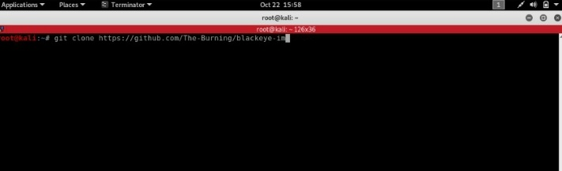
Open a terminal in Kali Linux and clone repository Blackeye using command git clone https:github.com/The-Burning/blackeye-im.

Slide 12
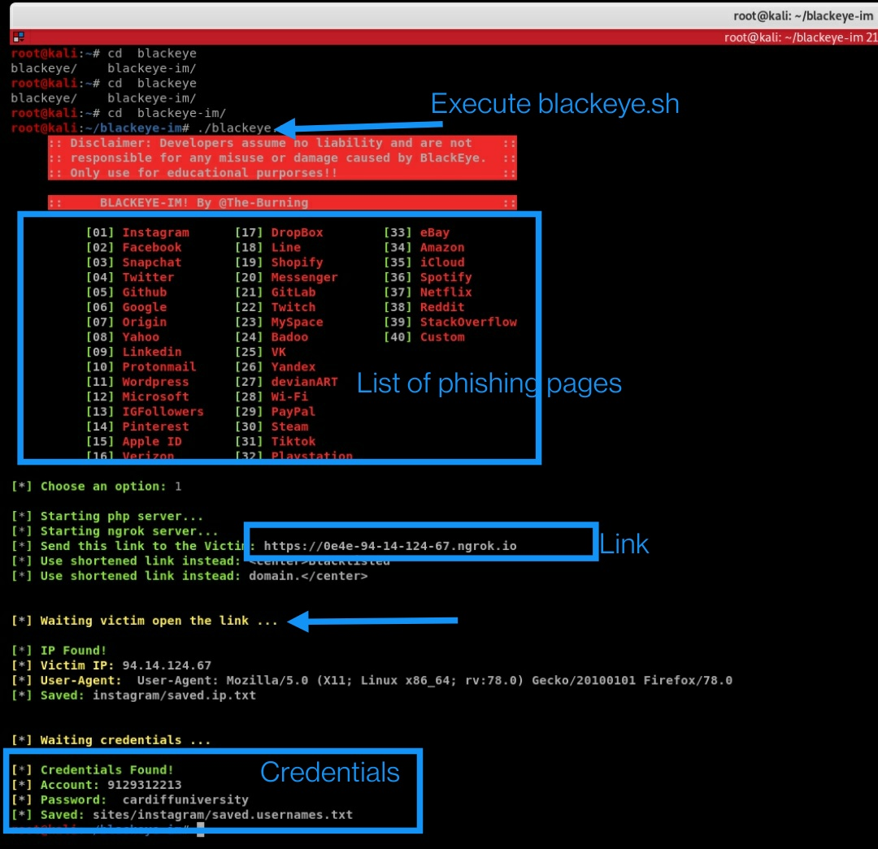
Execute command ./blackeye.sh: - It will provide the attacker with list of phishing pages. After selecting the phishing page the toot will generate a link and the attacker will try to share this link via emails, text messages or any other social media.
You can find the login pages of different websites and they are exactly identical to that particular page. The only difference in all the pages is the link.

Slide 13
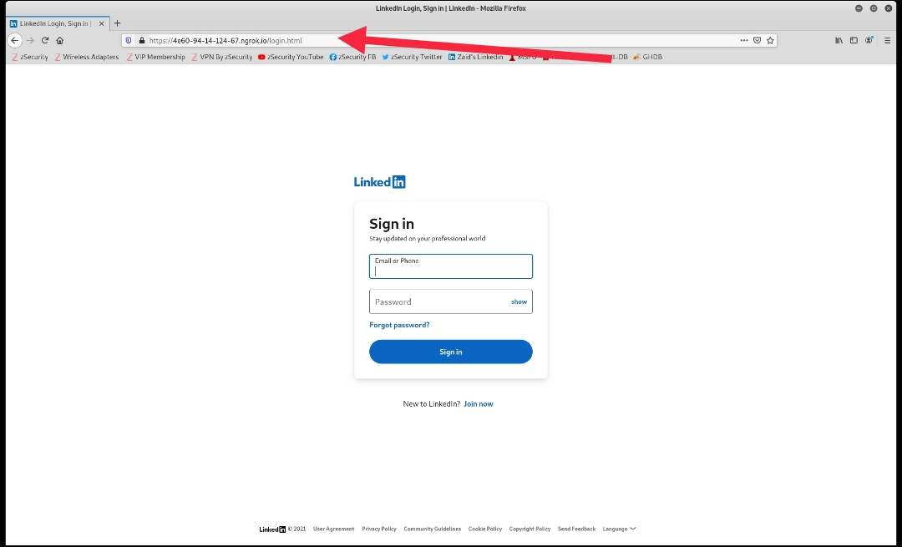
Here are a few examples of different phishing pages:-

Slide 14
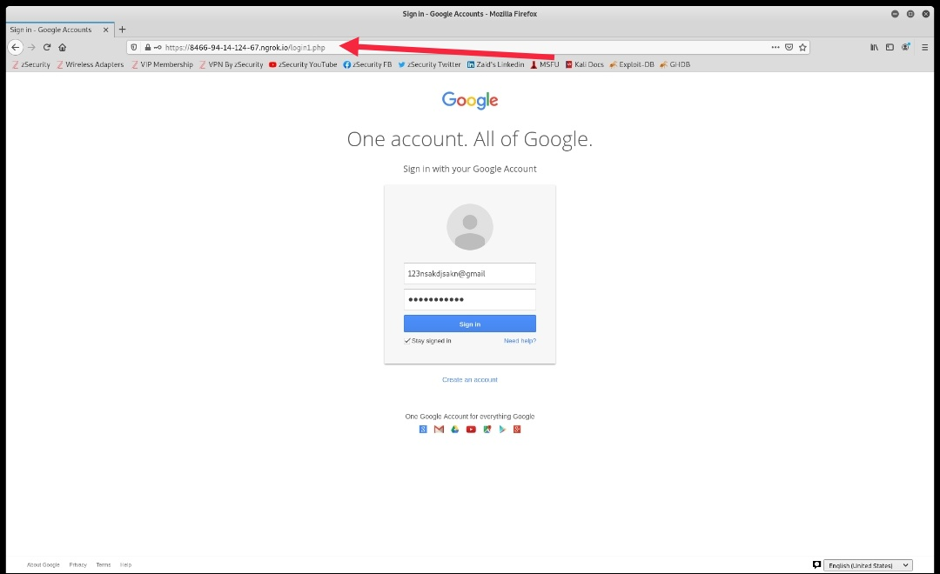
Google account login page

Slide 15
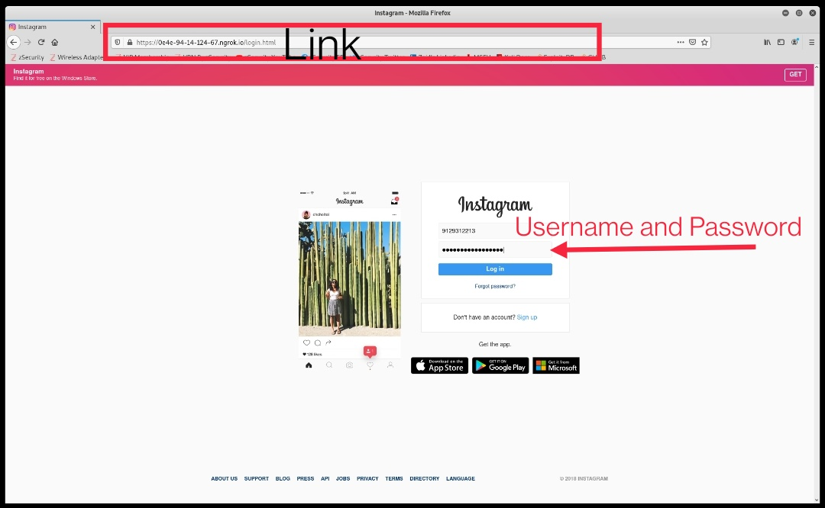
Now after the victim enters the credentials, instead of opening the page, it will just show an error or maybe redirect it to the original page and the victim might just think that there is just a glitch in the system.
What about the id and password??? They will be forwarded to the attacker.

Slide 16
Ways to be protected from phishing.
How to check if the URL is authentic?
One can always Check for a proper domain name. Domains like .top, .xyz, .store, .icu etc. are really suspicious and try not to open it.
If you are still not confident about the link, then there are few website validators through which we can know if the URL which you are accessing is authentic.
https://www.scam-detector.com/ here check for the rating and the reviews given by the victims before accessing it.

Slide 17
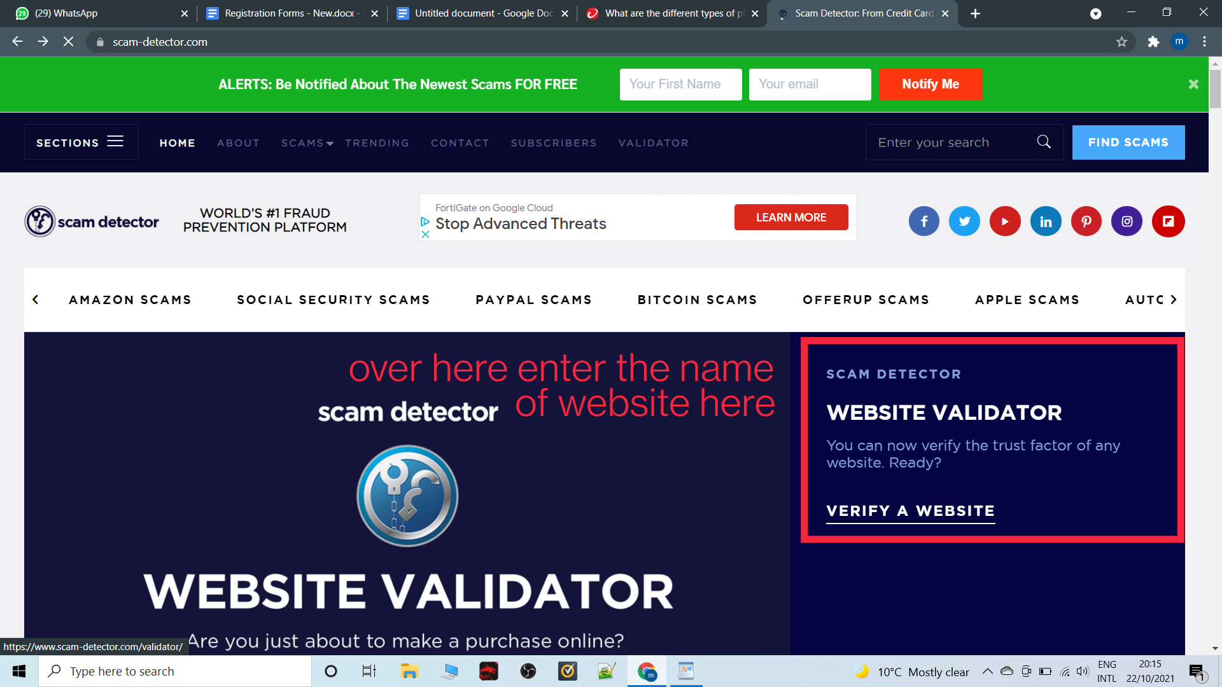

Slide 18
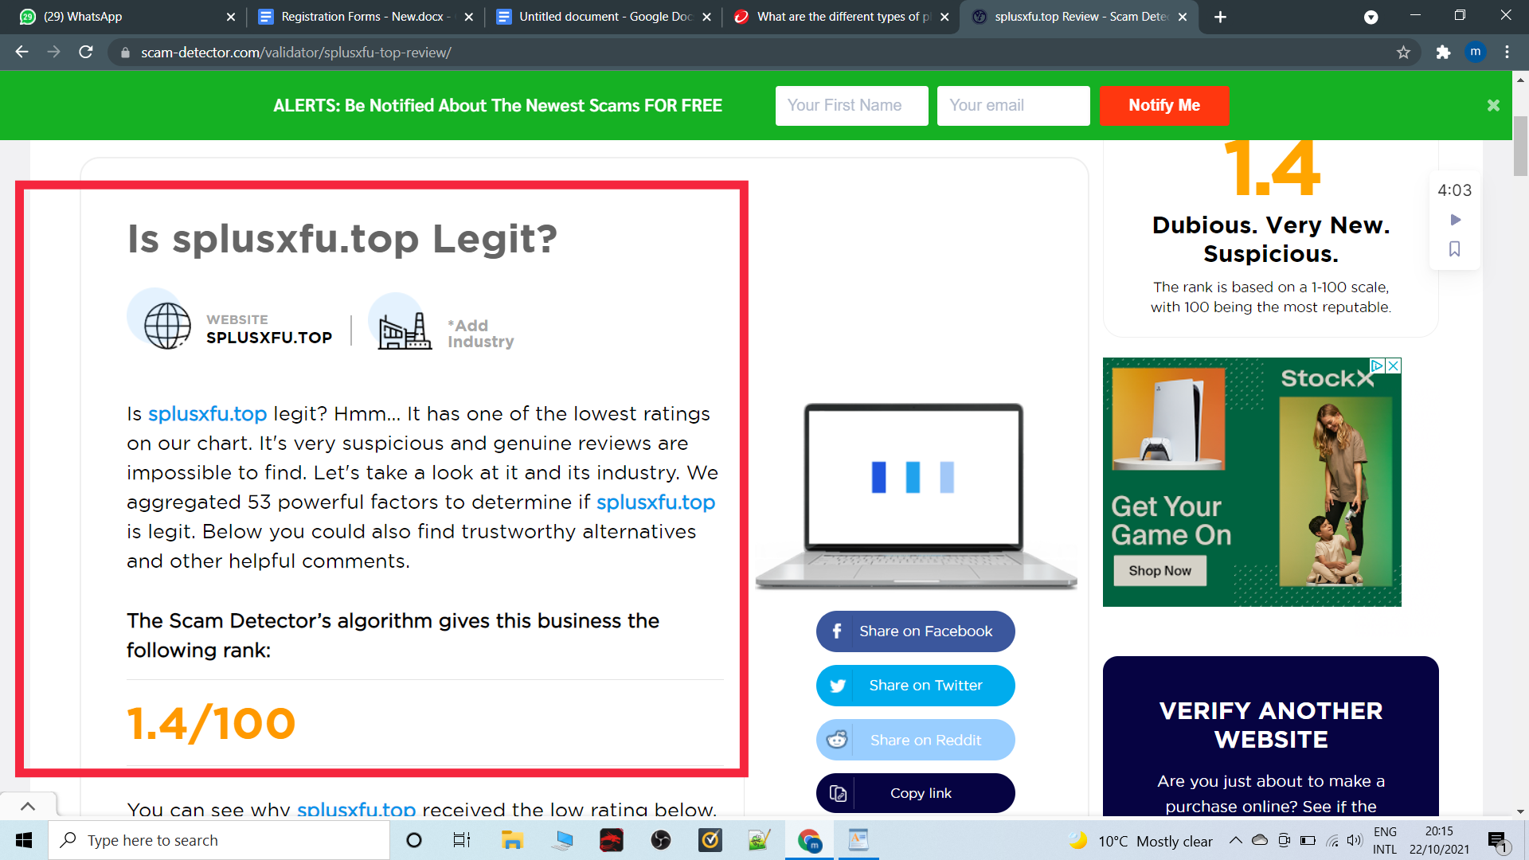

Slide 19
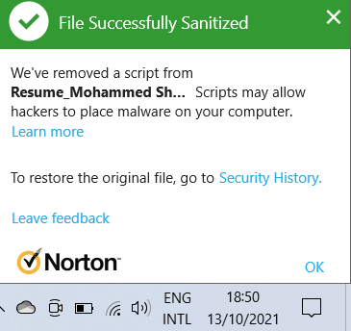
Ways to be protected from phishing.
Don’t download any attachments or access the URL’s if it is sent from an untrusted source.
Hackers can basically attach malicious software to any documents, images or any object.
Antivirus plays a very important role as it can detect malware or trojans.

Slide 20
Ways to be protected from phishing.
Use proper antivirus
If you are using a proper antivirus it will warn you if you access any suspicious website.
Do not respond to email or SMS if it is asking to reveal sensitive information pretending to be from reliable sources such as banks or government institutes.
If you receive any suspicious messages from your bank or any source do not respond via email or text messages, instead go to the bank personally and then deal with the problem.

Slide 21
Ways to be protected from phishing.
Spread awareness.
Phishing is one of the most simple cyber attacks which makes it the most threatening one.
Companies and universities should create programs to educate individuals on common phishing attacks and how to be careful from such attacks.
97% of users are not able to identify a sophisticated
phishing email.
– Intel Security

Slide 22
References
1. https://en.wikipedia.org/wiki/Phishing
2. https://www.webroot.com/gb/en/resources/tips-articles/what-is-social-engineering.
3. https://www.cyberriskaware.com/the-background-and-evolution-of-phishing
4. https://www.trendmicro.com/en_us/what-is/phishing/types-of-phishing.html
5. https://www.trendmicro.com/vinfo/us/security/definition/spear-phishing

Slide 23


THANK YOU

Slide 24
ANY QUESTIONS???

